Slide 1

A Structural Equation Modeling approach at explaining injuries in the NFL
Denise Bradford
EDPS 971 – Project
5/5/2020

Slide 2
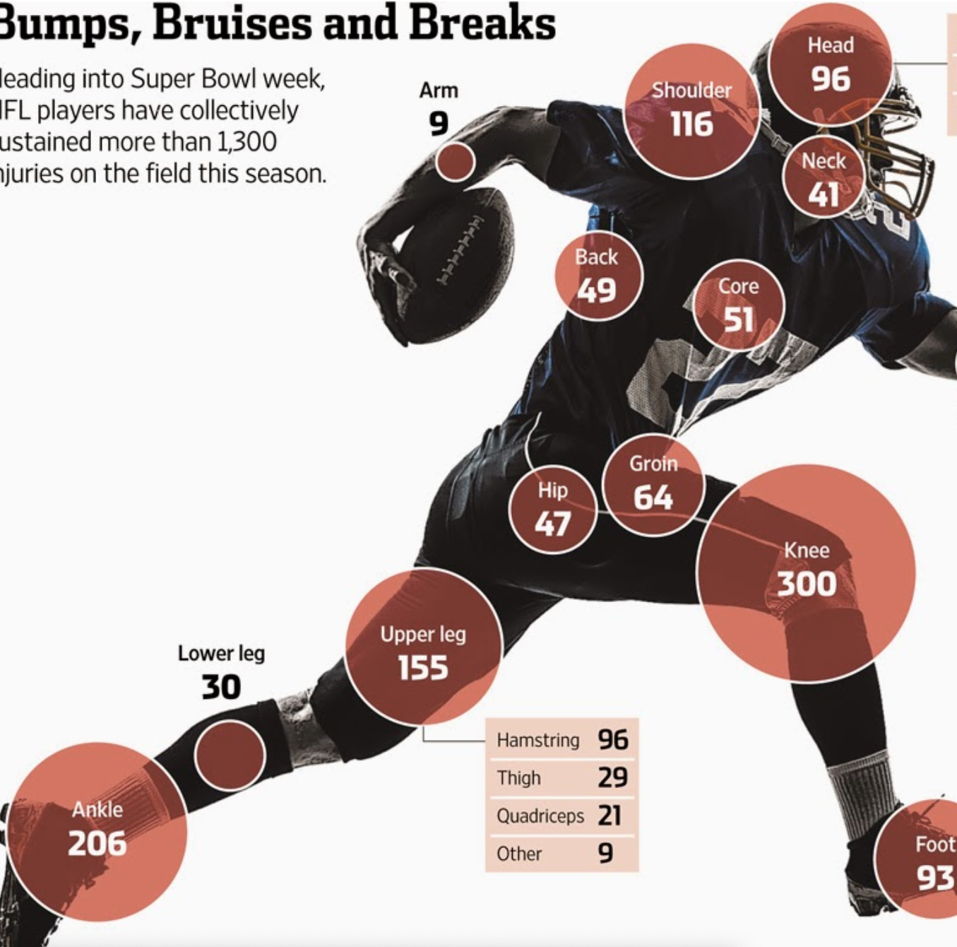
Motivation
The effect of artificial turf on injuries on players since the 1970s
Traditional players get hurt in the following ways:
Training/ training camps
During the game
Types of Injuries:
Concussions (CTE)**
Lower Body Injuries (foot, ankles, toes, knees)
Spine/ Spinal Cord and Back injuries*
Notes:
** As important as the topic is in the football world of injuries. This presentation will not include those injuries.
* The number of injuries have decreased dramatically with the advancements in technology of helmets and pads.

Slide 3
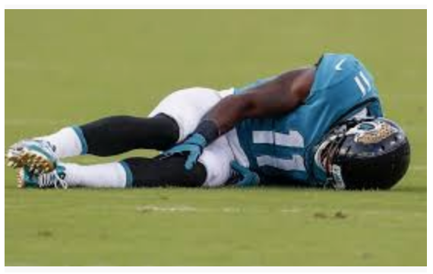
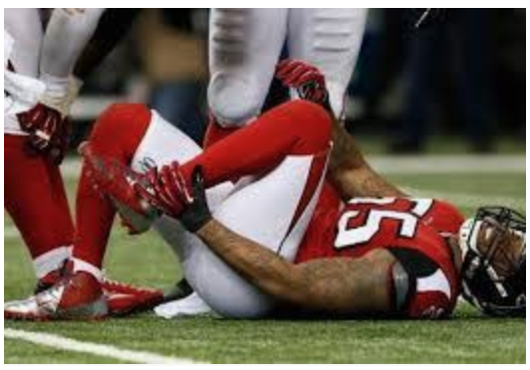
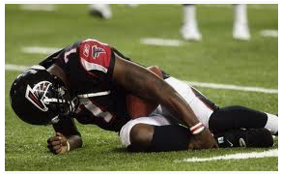
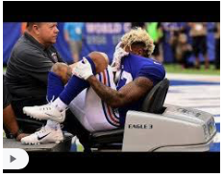
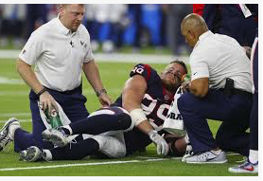

Slide 4
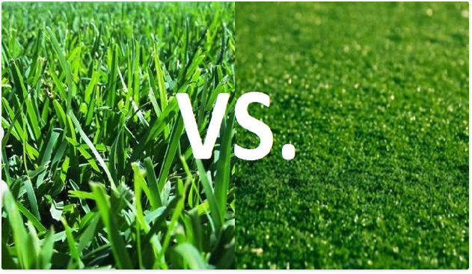
NATURAL GRASS
SYNTHETIC TURF
Notes:
Use this slide to drive home the differences on the body and the type of injuries for the player.

Slide 5
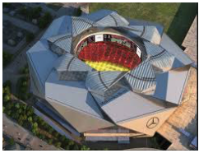
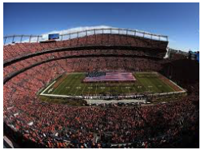
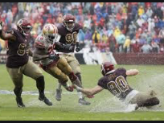
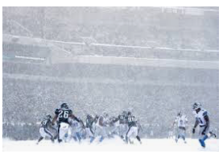
Types of Stadiums
Notes:
Use this slide to demonstrate the effects that the weather will have on the play of game, the turf vs natural grass, whether or the roof is open or not.

Slide 6
The Data
There are three files provided in the dataset, as described below:
Injury Record: The injury record file contains information on 105 lower-limb injuries that occurred during regular season games over the two seasons.
Play List: The play list file contains the details for the 267,005 player-plays that make up the dataset group.
Player Track Data: player level data that describes the location, orientation, speed, and direction of each player during a play recorded at 10 Hz (i.e. 10 observations recorded per second). ***
*** This data were not used for the current presentation but will be incorporated in future work.
Notes:
There are 105 players that are in the injury report. There are 77 players that were hurt in the middle of the game. As mention in the slide before, so players get hurt during training/ training camp. This was considered in the analysis.

Slide 7

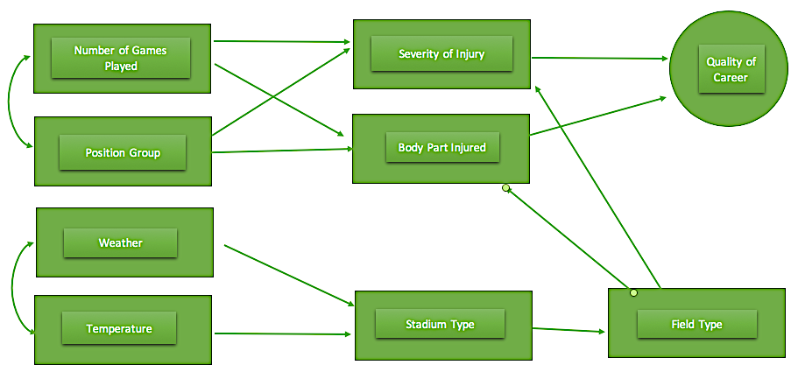
The Proposed Model
A Structural Equation Model approach of the influence of position group, league tenure, environmental conditions and stadium type factors on the quality of performance of an NFL player after an injury related to the game day conditions that lead up to the injury.
Notes:
** As important as the topic is in the football world of injuries. This presentation will not include those injuries.
* The number of injuries have decreased dramatically with the advancements in technology of helmets and pads.

Slide 8
The Latent Growth Curve Model
Notes:
There are obvious correlations between the Field type, Weather Factor and Stadium Type.
**As the model stands now, it works to produce a very interesting outcome. I would like to incorporate the position group, the number of games that the player as well as the number of games that the player has played. This model could also take on the amount of time that the player has played in the league as a result to the time limit for the class, I didn’t get to this point just yet.

Slide 9
Analysis
Created an injury variable
(0 = no injury during the game, and 1 = injury during the game)
Categorized Variables
Weather Factor
Sunny, snow, overcast, rain, & indoor
Stadium Type Factor
Outdoor, Domed & Indoor
Field Type
Synthetic (turf) or Natural (grass)
Notes:
* Originally, there were weather types that included things like:
Sunny with a chance of rain
60% chance of rain
Originally, the stadium types included:
Domed open
Domed closed
Retractable roof

Slide 10

The Model Formality
A Bayesian Generalized Linear Mixed Model from a multilevel modeling context was used
Logistic regression with a response
Wishart distribution priors were used (basically a gamma distribution in multiple dimensions)
Notes:
Based on the model we will have the covariates in the simple model will be a Field Type
The desired model will have covariates Field Type, Stadium Type Factor and Weather Factor
Decided to take the following equations out due to the audience
$$η_{ij}=x_{ij}^{′}β+ {z_{ij}^{′}v}_{i}$$
$$g\left(μ_{ij}\right)=logit\left(μ_{ij}\right) where μ_{ij}=E\left[Y_{ij} | v_{i},x_{ij}\right]$$

Slide 11
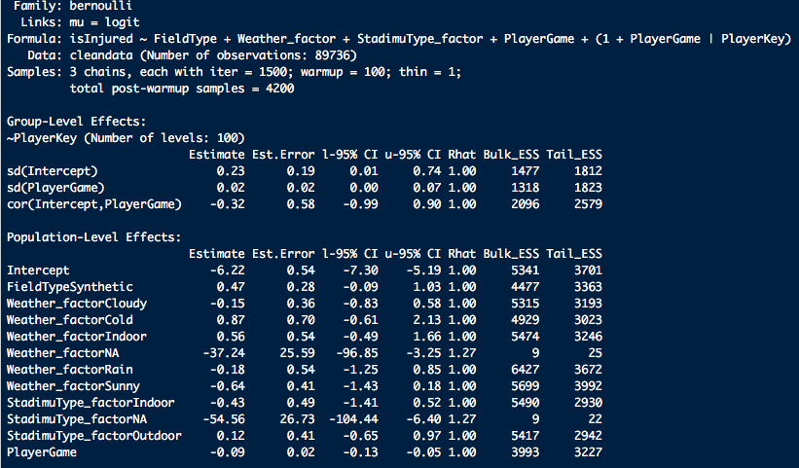
Bayesian Analysis (a STAN package)
Notes:
This model did not converge, I will use a different Bayesian package in order to get some estimates that I can present. As you can see, there were 3 chains with 1500 iterations. The model as it is, took ~ 20 hours (I’m not sure since this completed while I slept. LOL).

Slide 12
Results (Simple Model)
Random Effects | Variance | Std. Deviation | Correlation
Player Key (Intercept) | 0.596594 | 0.77240
Player Game | 0.005377 | 0.0733 | - 0.95
Fixed effects | Estimate | Std. Error | Z-value | Pr(>|z|)
(intercept) | -6.45394 | 0.25020 | -25.795 | < 2e-16 ***
Field Type Synthetic | 0.41561 | 0.23255 | 1.787 | 0.0739
Player Game | -0.08886 | 0.02220 | -4.003 | 6.26e-05 ***
Notes:
In this model we simplify the model so that we can see if we can prove that there is a differences between the injuries in the field type. This is will prove that the field type differences are slightly significant on a 0.05 alpha level, but in the event that we are looking at a 0.08 significance, we see the difference.
AIC BIC logLik deviance df.resid
1230.0 1286.4 -609.0 1218.0 89730
Scaled residuals:
Min 1Q Median 3Q Max
-0.058 -0.032 -0.026 -0.020 49.183
Estimate Std. Error z value Pr(>|z|)
(Intercept) -6.45394 0.25020 -25.795 < 2e-16 ***
FieldTypeSynthetic 0.41561 0.23255 1.787 0.0739 .
PlayerGame - 0.08886 0.02220 -4.003 6.26e-05 ***

Slide 13
Results (Desired Model)
Random Effects | Variance | Std. Deviation | Correlation
Player Key (Intercept) | 1.03929 | 1.01946
Player Game | 0.00805 | 0.08972 | - 0.97
Fixed Effects | Estimate | Std. Error | z value | Pr(>|z|)
(Intercept) | -6.229291 | 0.554612 | -11.232 | < 2e-16 ***
FieldTypeSynthetic | 0.488659 | 0.280914 | 1.74 | 0.0819 .
Weather_factor_Cloudy | 0.002542 | 0.379344 | 0.007 | 0.9947
Weather_factor_Cold | 1.388045 | 0.667229 | 2.08 | 0.0375 *
Weather_factor_Indoor | 0.721247 | 0.570286 | 1.265 | 0.206
Weather_factor_NA | -11.357927 | 13.910234 | -0.817 | 0.4142
Weather_factor_Rain | 0.188177 | 0.527726 | 0.357 | 0.7214
Weather_factor_Sunny | -0.50224 | 0.431765 | -1.163 | 0.2447
StadimuType_factor_Indoor | -0.570537 | 0.505221 | -1.129 | 0.2588
StadimuType_factor_NA - | -11.74238 | 22.887594 | -0.513 | 0.6079
StadimuType_factor_Outdoor | -0.060659 | 0.406868 | -0.149 | 0.8815
PlayerGame | -0.097668 | 0.023905 | -4.086 | 4.39e-05 ***
Notes:
In this model we
AIC BIC logLik deviance df.resid
1219.3 1360.4 -594.6 1189.3 89721
Scaled residuals:
Min 1Q Median 3Q Max
-0.081 -0.032 -0.024 -0.015 56.854
Fixed effects:
Estimate Std. Error z value Pr(>|z|)
(Intercept) -6.229291 0.554612 -11.232 < 2e-16 ***
FieldTypeSynthetic 0.488659 0.280914 1.740 0.0819 .
Weather_factor_Cloudy 0.002542 0.379344 0.007 0.9947
Weather_factor_Cold 1.388045 0.667229 2.080 0.0375 *
Weather_factor_Indoor 0.721247 0.570286 1.265 0.2060
Weather_factor_NA -11.357927 13.910234 -0.817 0.4142
Weather_factor_Rain 0.188177 0.527726 0.357 0.7214
Weather_factor_Sunny -0.502240 0.431765 -1.163 0.2447
StadimuType_factor_Indoor -0.570537 0.505221 -1.129 0.2588
StadimuType_factor_NA -11.742380 22.887594 -0.513 0.6079
StadimuType_factor_Outdoor -0.060659 0.406868 -0.149 0.8815
PlayerGame -0.097668 0.023905 -4.086 4.39e-05 ***

Slide 14
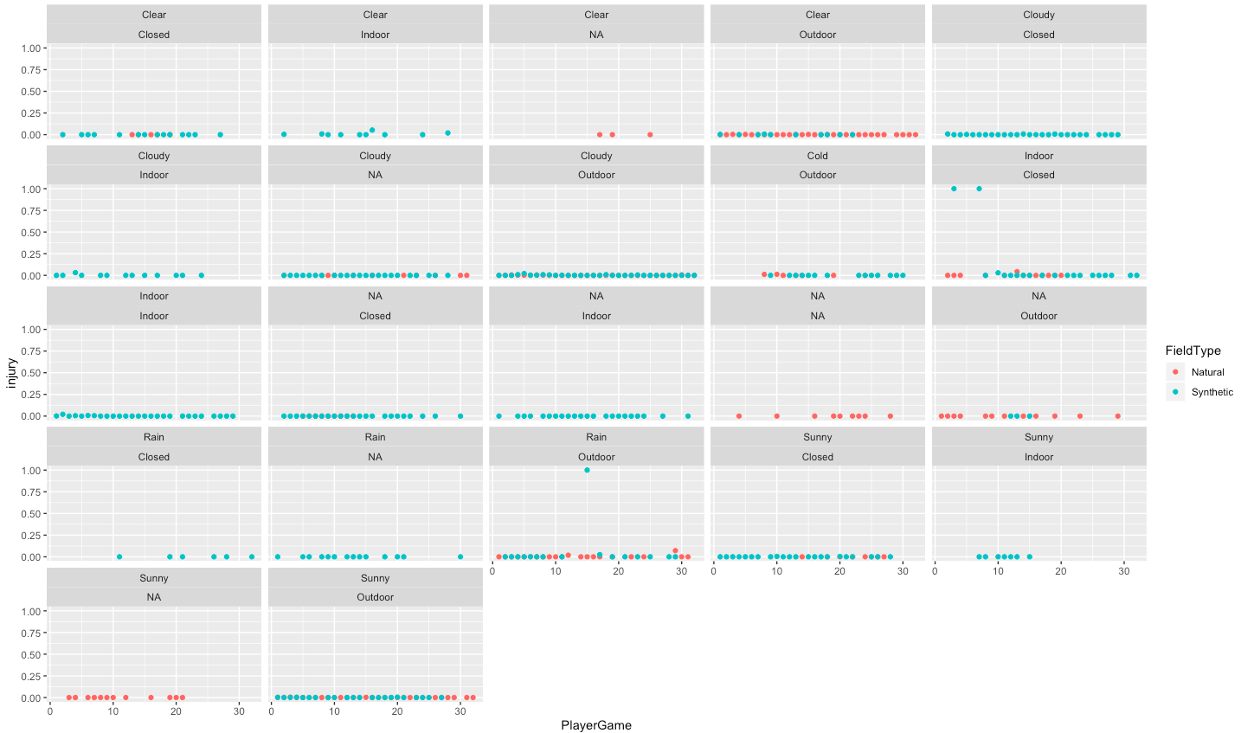
Visually

Slide 15
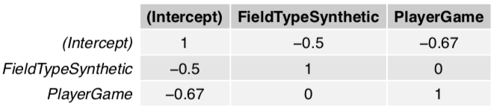
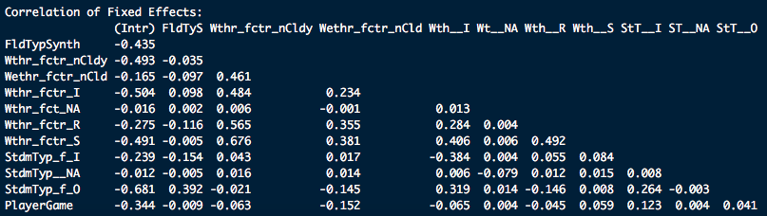
Correlation Matrices
Simple Model
Desired Model
Notes:
Correlation matrix for fixed effects in each model.

Slide 16
Conclusions
Work on a simpler dataset for a class project once in my career
Our model, has confirmed the thought behind the differences in the Synthetic turf and the Natural grass fields.
In desired model, evidence that there are differences between the field type and the cold weather factor

Slide 17
Future Work
Extend model to include more factors
Player Position Group (WR, RB, LB, QB)
Severity of Injury (The amount of time player out of game)
Play time during the game
Body Part (knee, toes, foot, ankle)

